Slide 1
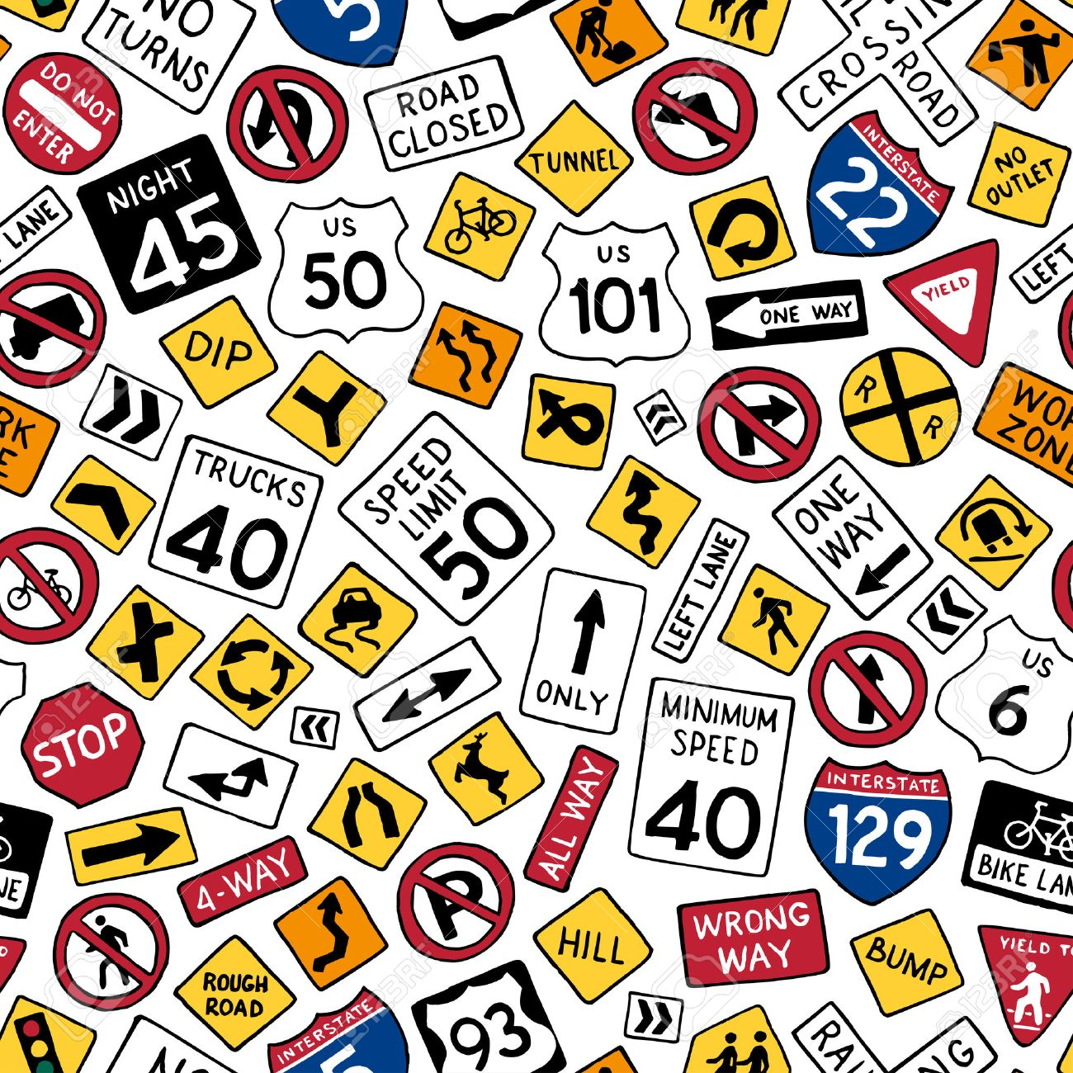
TRAFFIC SIGN CLASSIFICATION
Anjali Sebastian
Kruta Prabhu
Kshama Kumar

Slide 2
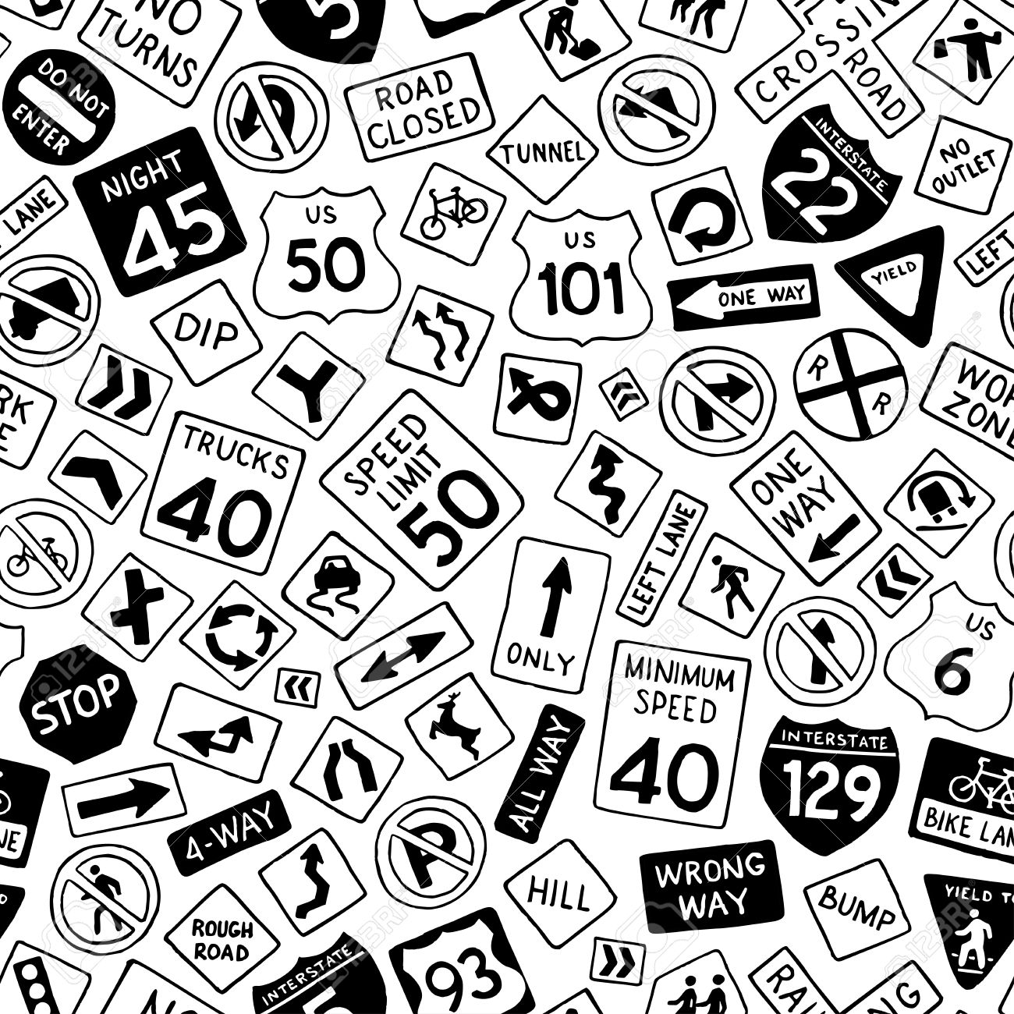
Introduction
38,000+ people die every year in US due to car crashes
DUI, bad weather, poor visibility, missed traffic signs
Autonomous Vehicles. Safety Technology - Blindspot detection, lane guidance, auto braking at low speeds.
Project aims to look at traffic signs:
Correlation between traffic signs and accidents
Traffic Sign Image Recognition Model
Notes:
We are aiming to solve a part of this problem by looking at …

Slide 3

Data
1.5 million records of accidents that occurred in US based on severity.
47 features: Geo Location, Weather Information.
Presence of roundabout, stop, no-exit, etc.
4 levels of increasing severity.
Heavily imbalanced data (80% is Class 2 Severity, 1.8% Class 1 Severity)
39,209 images of traffic signs from DE
12,630 unseen test images
43 different classes
Some imbalance 200 to 2220
Manually hand annotated images from Google Street view.
49 images from FR and DE
49 images from accident sites in WA.
Notes:
We are aiming to solve a part of this problem by looking at …

Slide 4











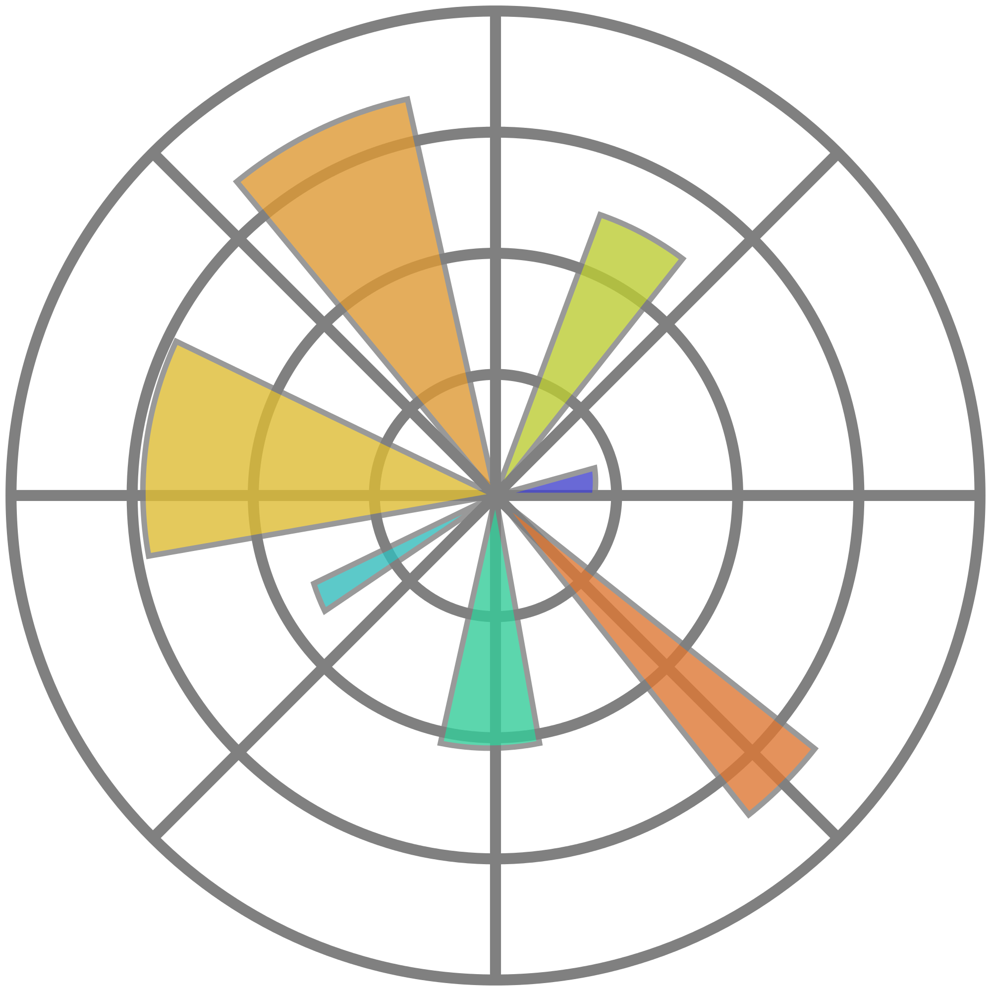


Workflow Design
Data Collection
Data Cleaning Pre-processing
Image Pre-processing
Deep Learning
(CNN)
Image Data
Accident Data
Image Classification
Geo-map location to Street-view
Correlation – Traffic Sign & Accident
EDA & Visualization
Feature Importance
Test on Signage from Street-view

Slide 5
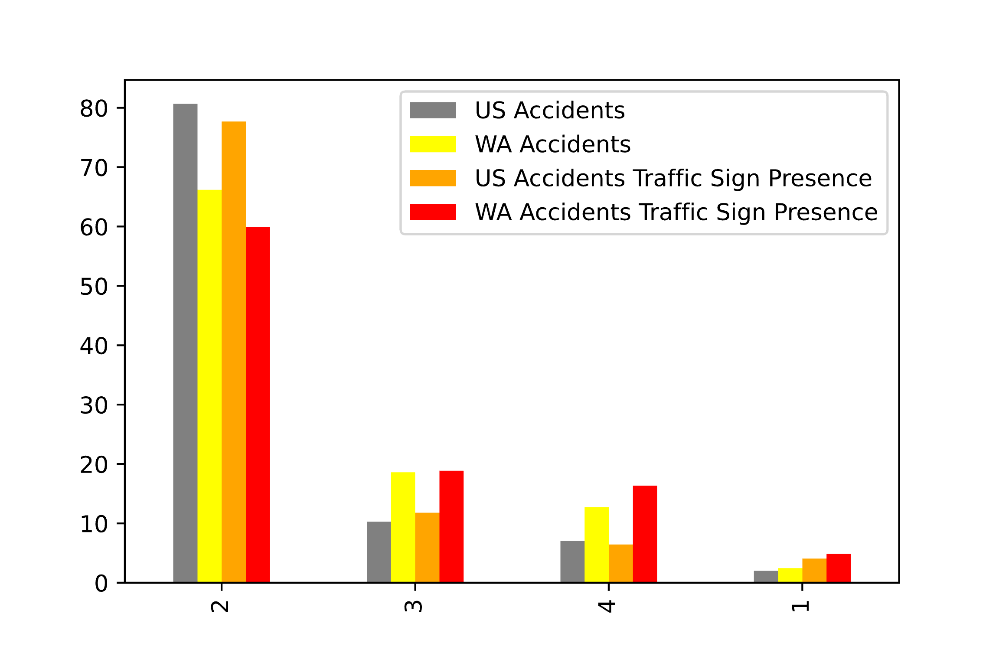
Do Traffic Signs Matter ?
Yes
Presence of Traffic Sign reduces the chance of a Class 2 Severity Accident.
What Class the increases?
Class 1,3
Class 4 for WA
WA in comparison to US
Mean (2.2 vs. 2.4)
Humidity and Pressure
Notes:
We are aiming to solve a part of this problem by looking at …

Slide 6
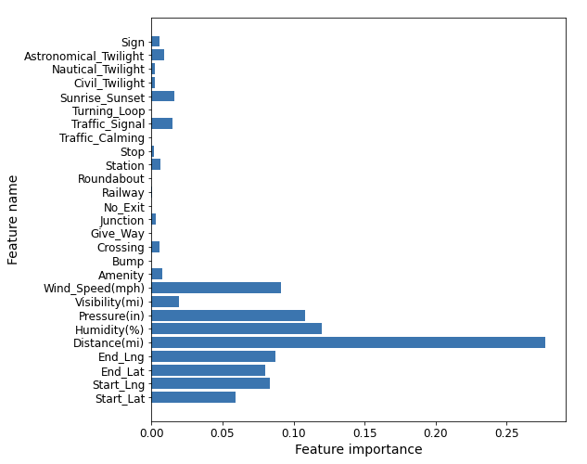
Which Features are Important for Accidents that happened in WA?
Decision Tree Classifier
Distance and Severity
Pressure, Humidity and Windspeed
What about Traffic Signs: Yes, but less that weather
Traffic Signal – most important of all the signs.
Why are geo-coordinates important?
Notes:
We are aiming to solve a part of this problem by looking at …

Slide 7
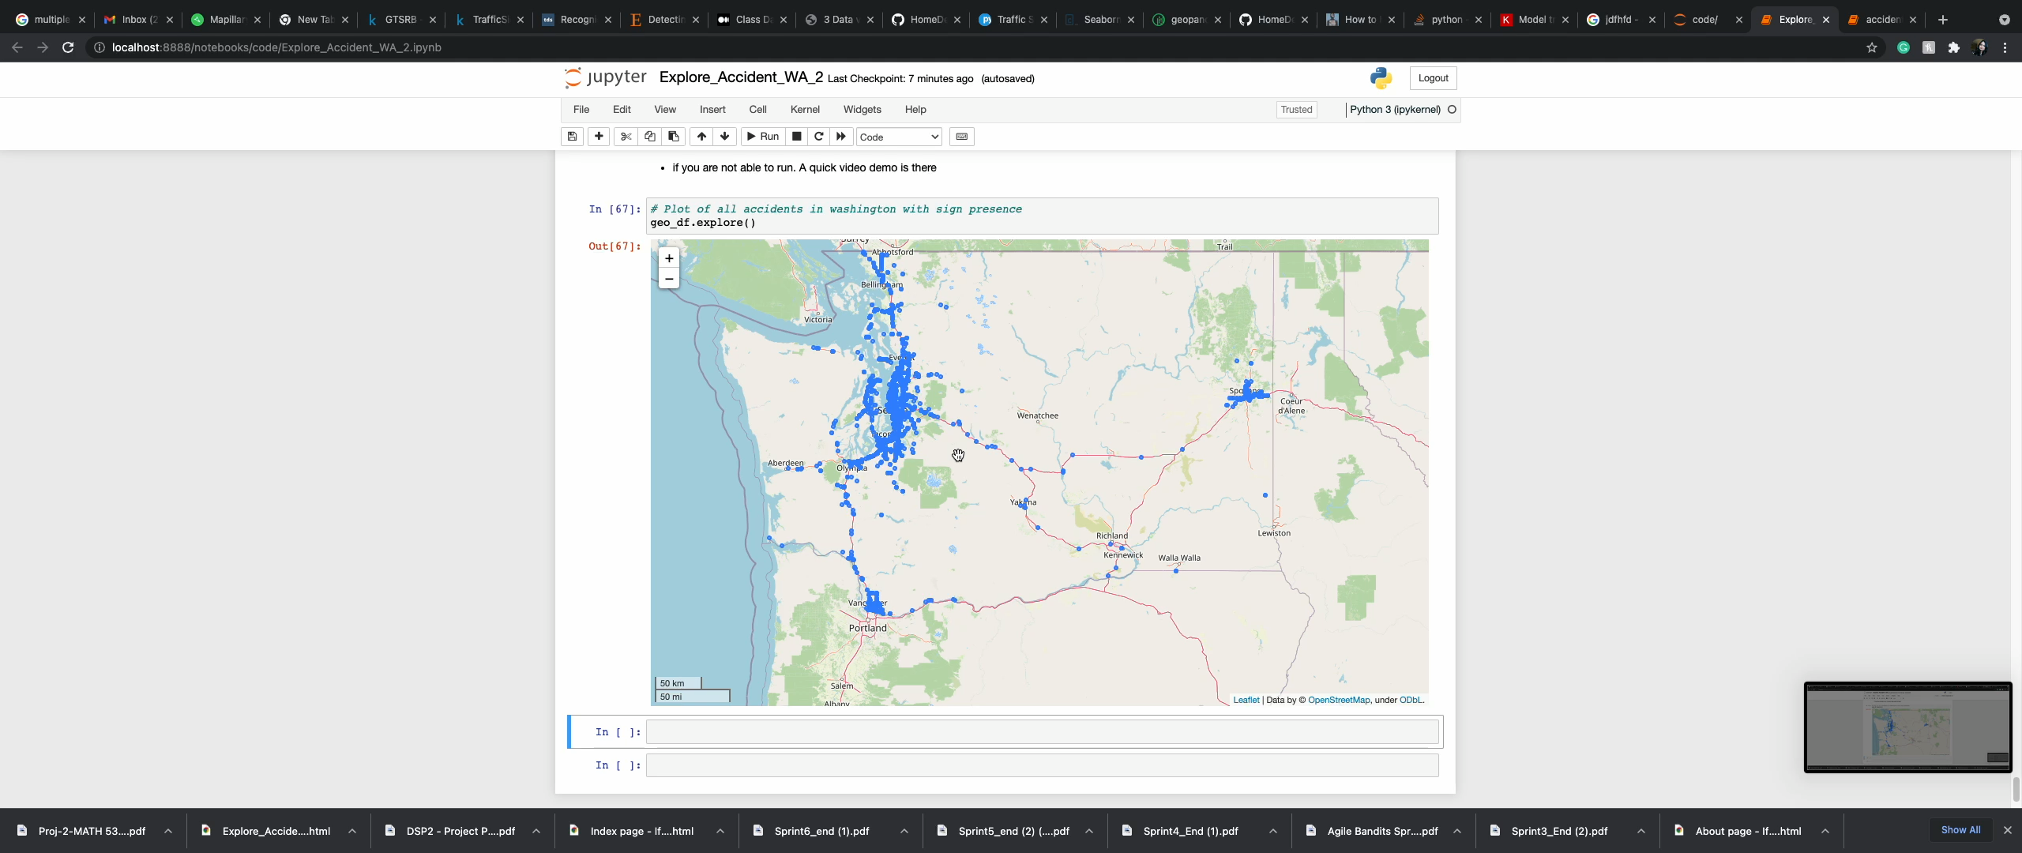
Plotting Geo-Locations of Accidents

Slide 8






CNN Model
Class 14
Class 0
Image
Conv 2D
Conv 2D
Max-pooling
Dropout
Conv 2D
Conv 2D
Max-pooling
Dropout
Flatten
256 Neurons
Dropout
43 Neurons
Class 9
10 epochs with ES
70-30 Split
96% Accuracy Training
98.63% Accuracy Validation
Class 36
Convolution Layer
Max-pooling
Fully Connected
Dropout Layer
Class 40

Slide 9
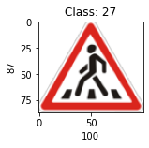
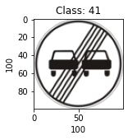
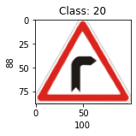
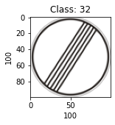
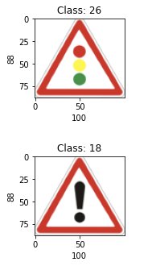
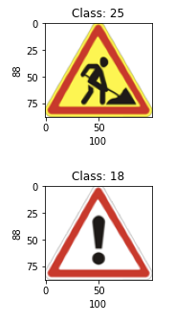
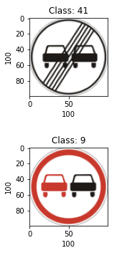
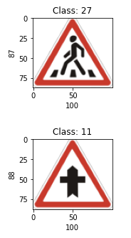
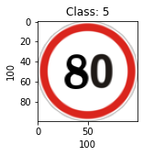
Validation Results
Accuracy = 0.98
Lowest Recall = 0.93
Classes with lowest recall = 27, 32, 41
Lowest Precision = 0.95
Class with lowest precision = 5
Results on Unseen Test Data
Accuracy = 0.95
Lowest Recall = 0.55, Class 41, 27
Lowest Precision = 0.77, Class 20

Slide 10
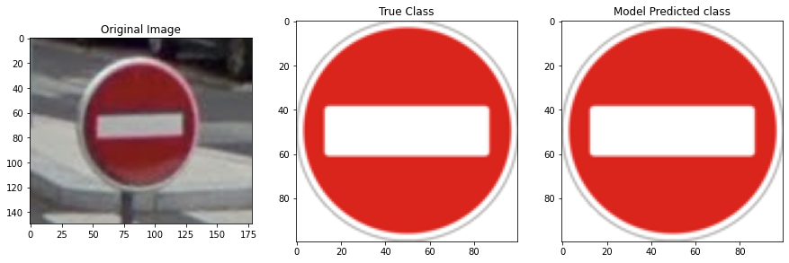
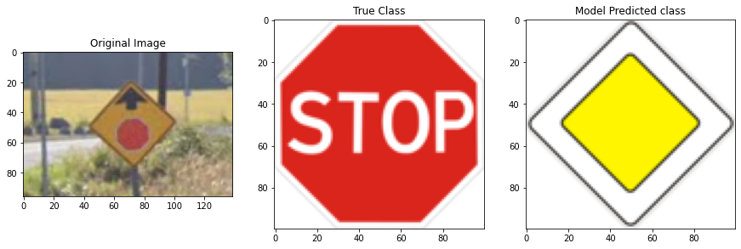
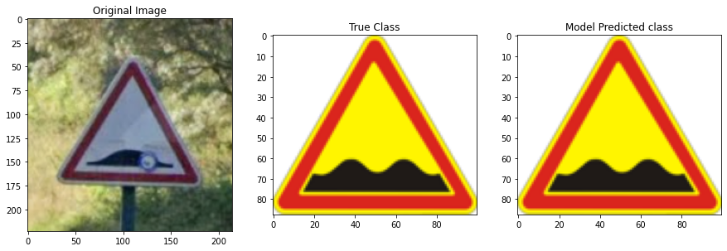
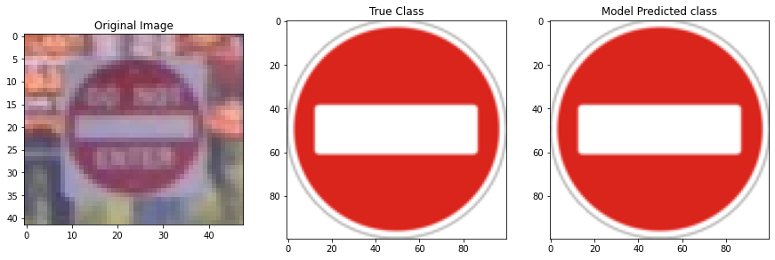
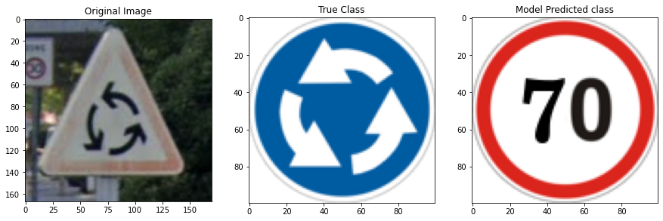
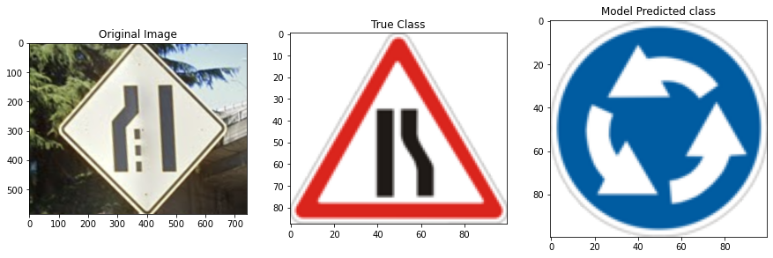
Images from FR and DE
Correctly predicts the class 45% of the time
Images from Accident Sites in WA Correctly predicts the class 16% of the time
Testing on Images from Google Street-view

Slide 11
Challenges & Future Work
Google Images: No automation location- based image collection.
Uses significant resources to train any image model – AWS is a must.
Large data difficult to process and move.
Try to find images for US signs
Add image-processing for combating bad image angles/skew and removal of background.
Traffic signs are only a small subset of all the signs on a road.
Detecting traffic signs from a full scene.

Slide 12
THANK YOU

Slide 13
ANNEXURES

Slide 14
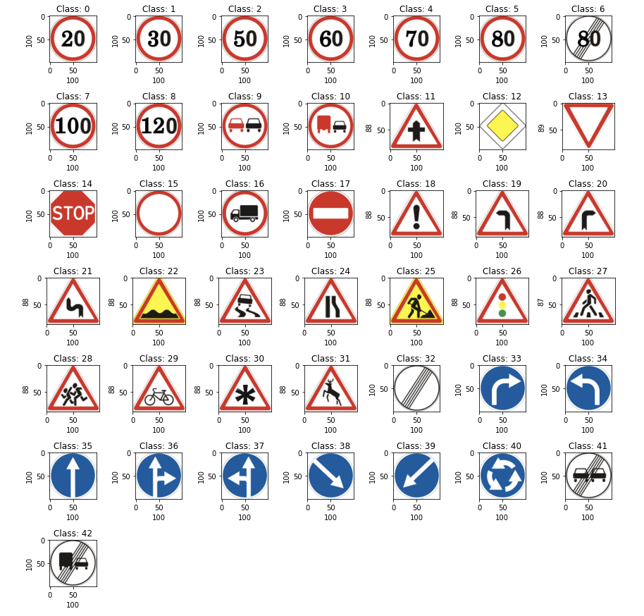
META CLASSES

Slide 15
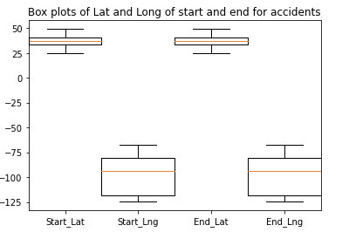
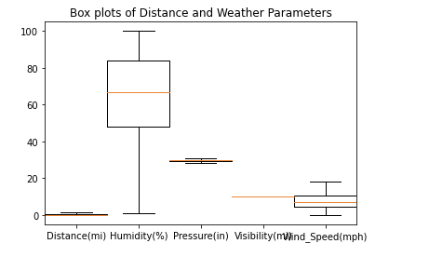
BOXPLOTS: ALL STATES

Slide 16
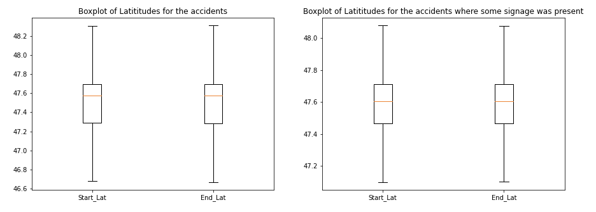
BOXPLOTS: WA ACCIDENTS -1

Slide 17
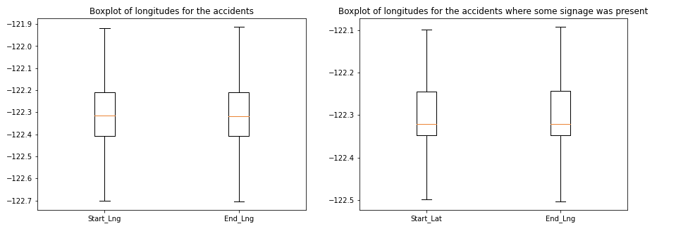
BOXPLOTS: WA ACCIDENTS -2

Slide 18
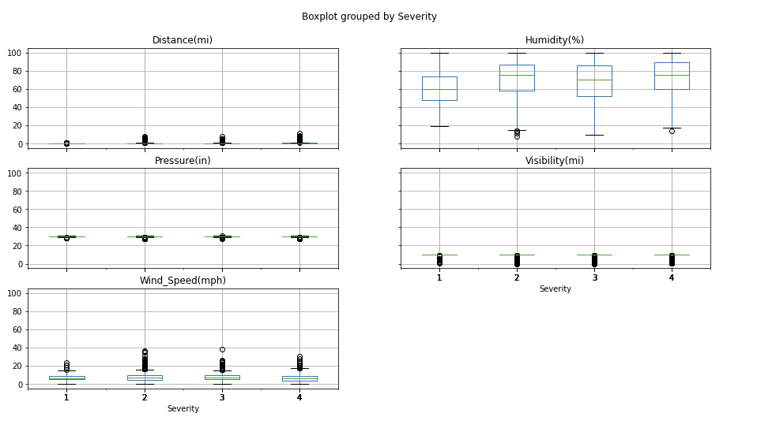
BOXPLOTS: WA ACCIDENTS -3

Slide 19
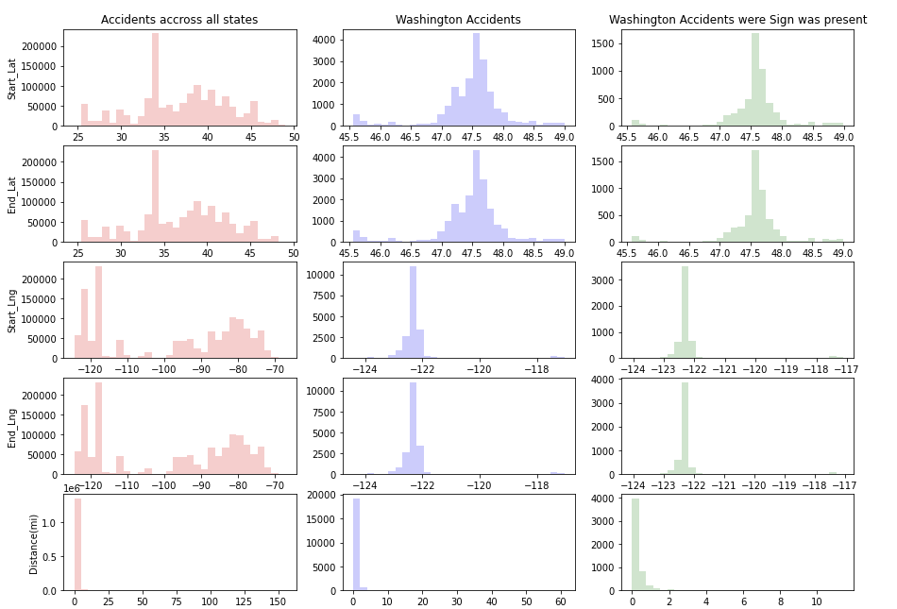
Histograms -1

Slide 20
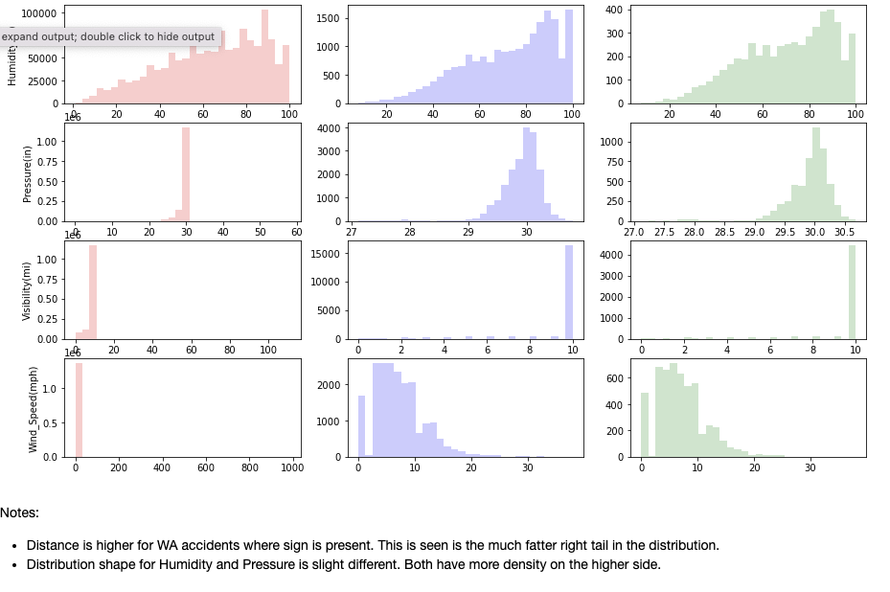
Histograms -2

Slide 21
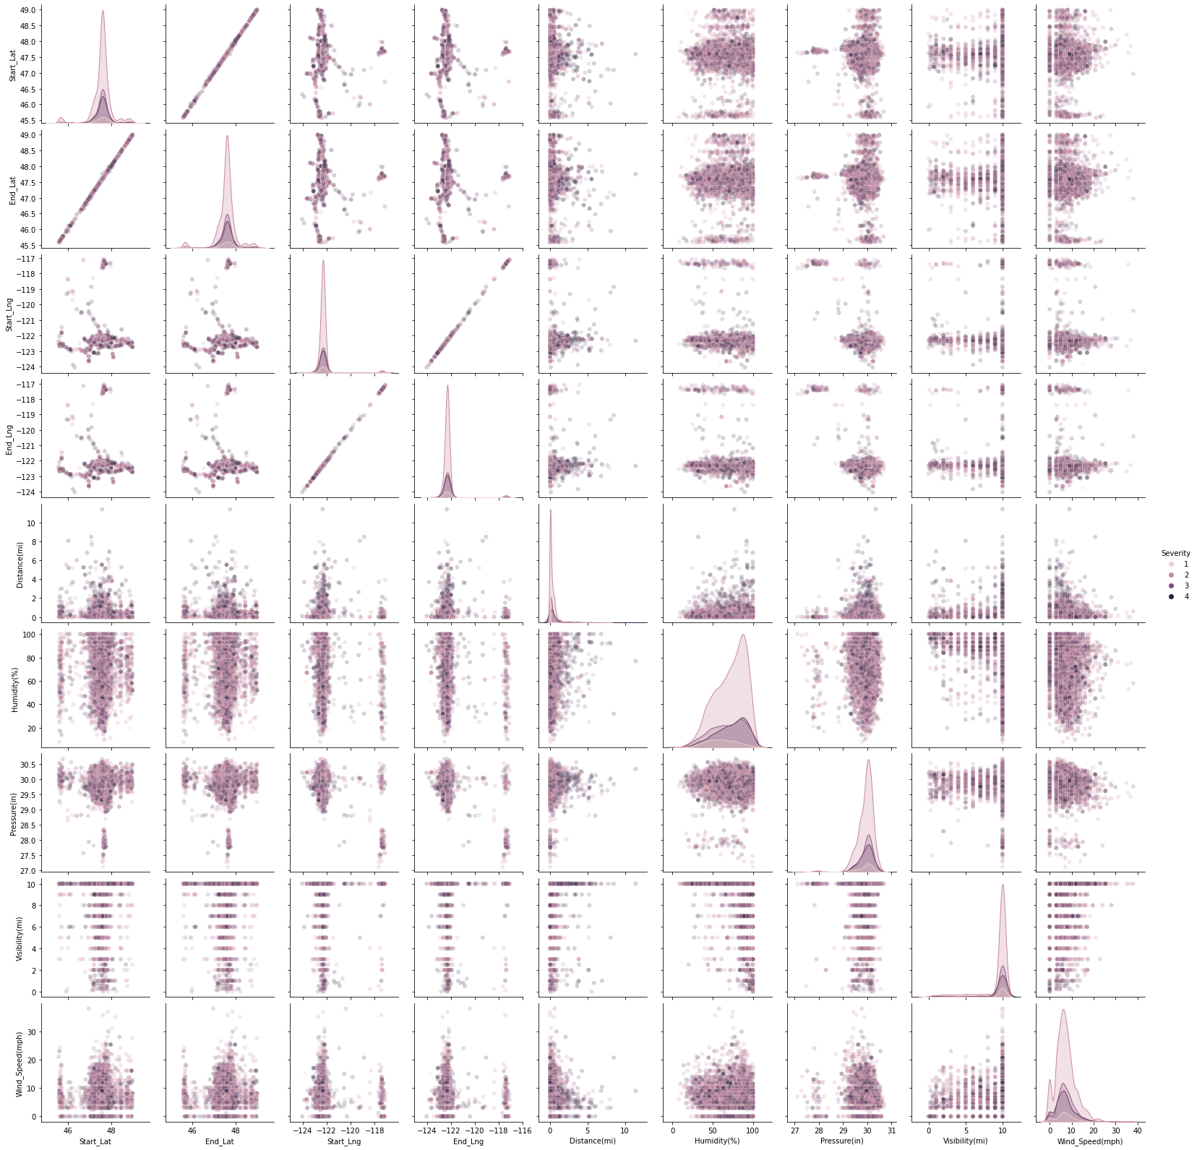
Pair-plots

Slide 22
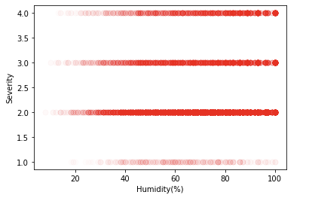
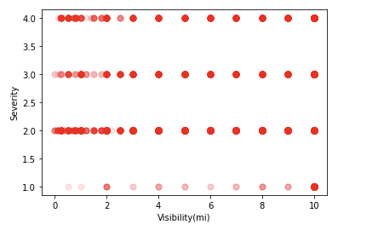
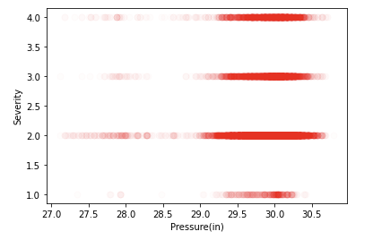
SCATTER PLOTS

Slide 23
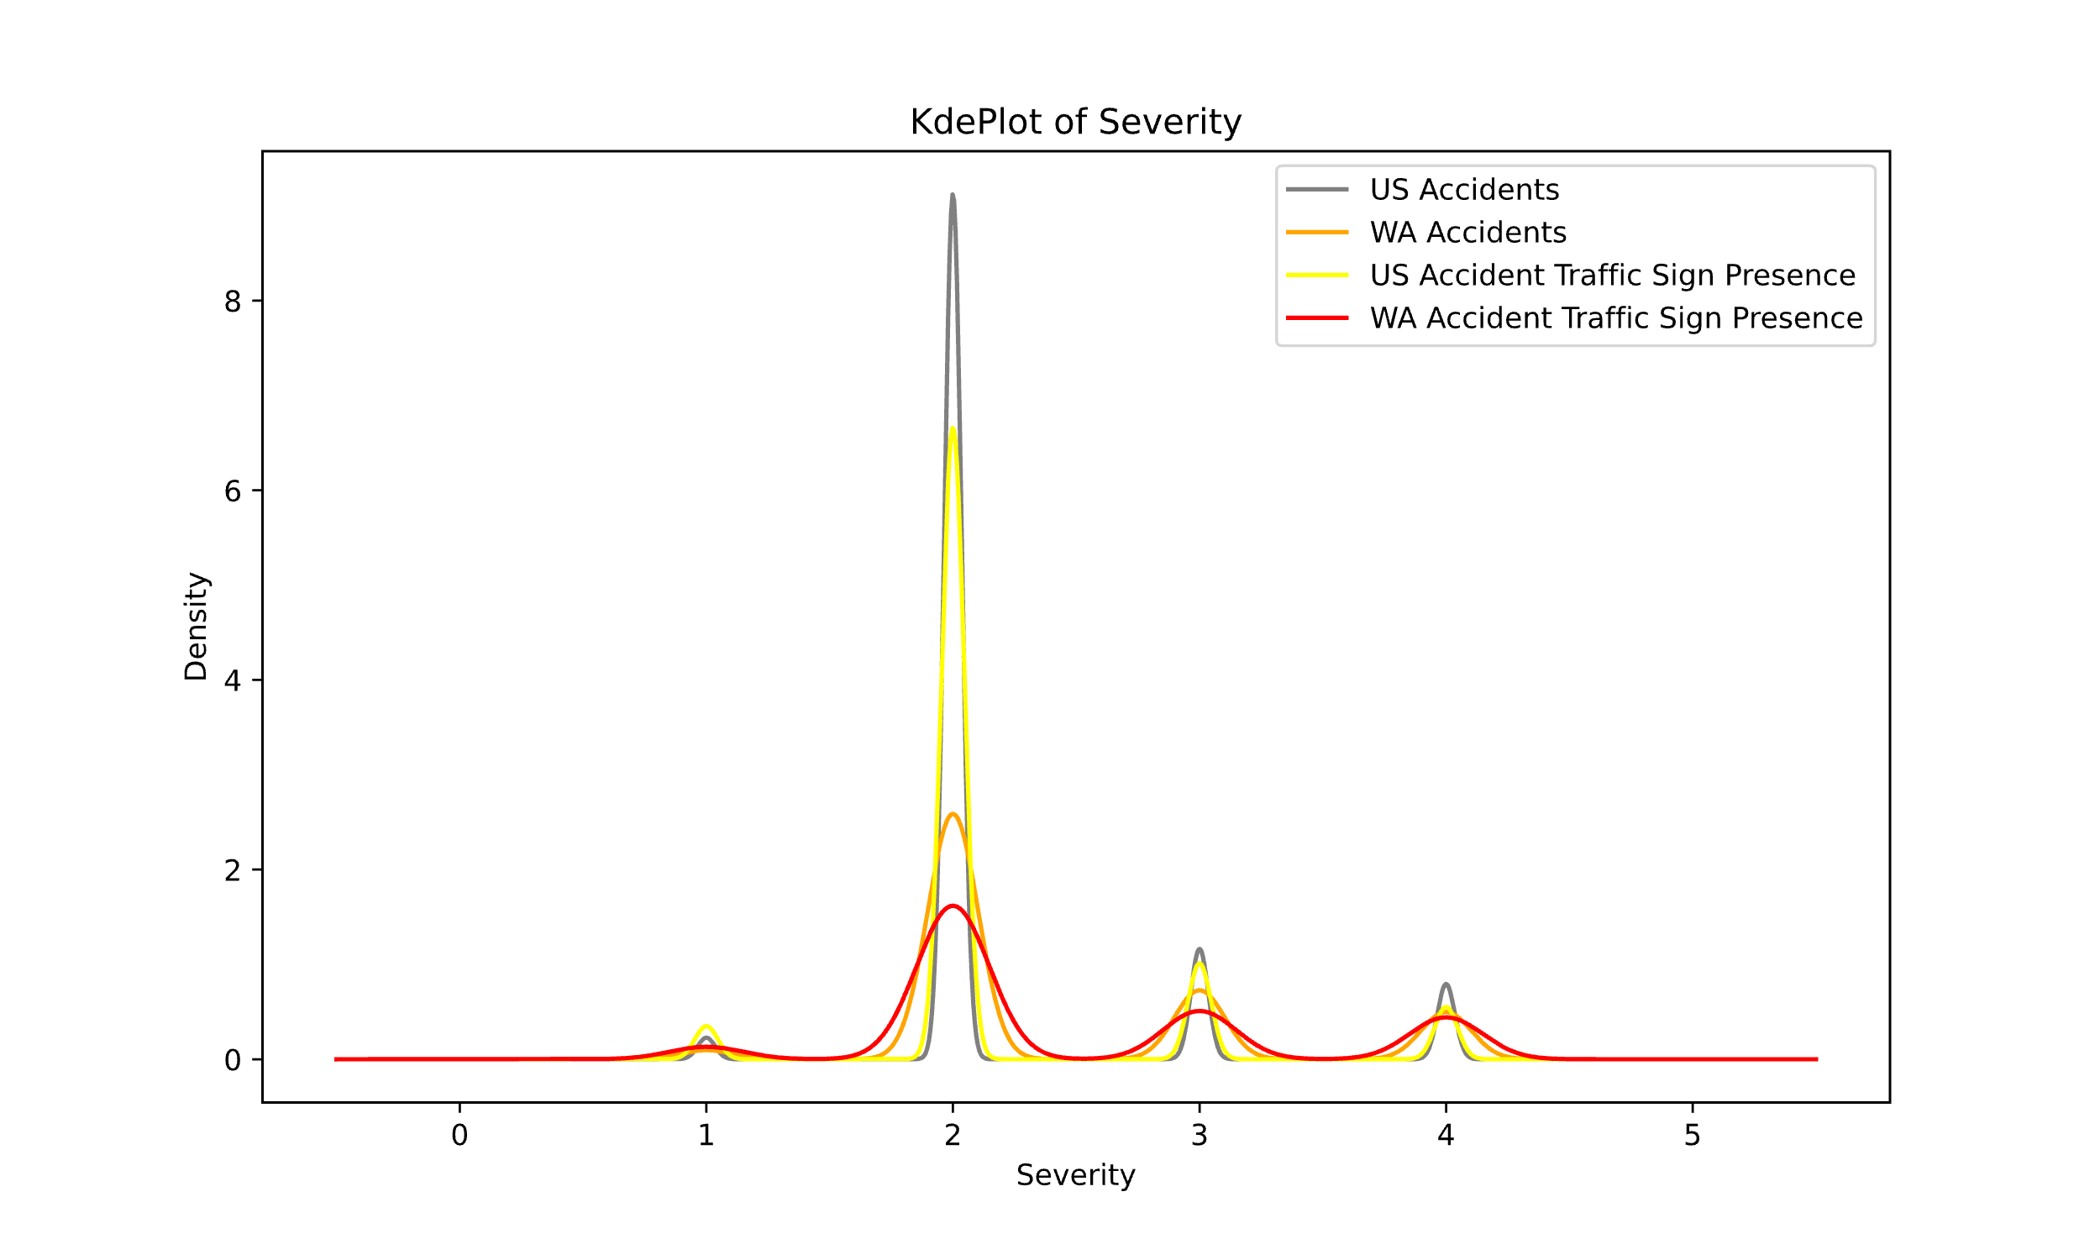
KDE PLOT OF SEVERITY

Slide 24
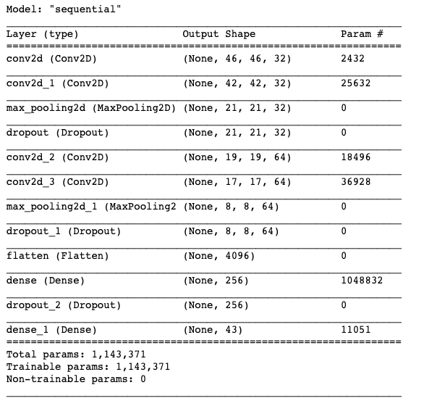
DETAILED ARCH

Slide 25
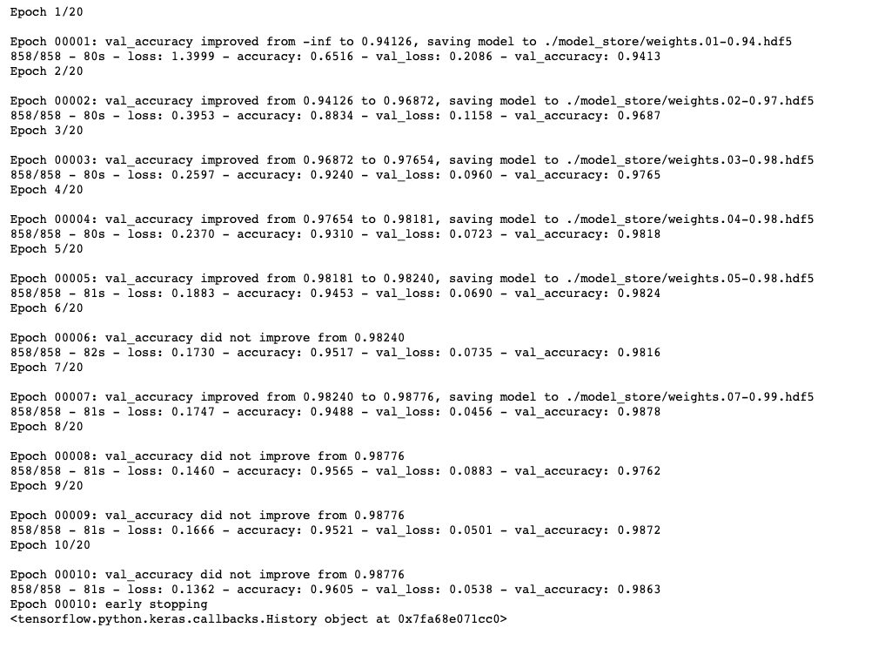
TRAINING THE MODEL WITH EARLY STOPPAGE

Slide 26
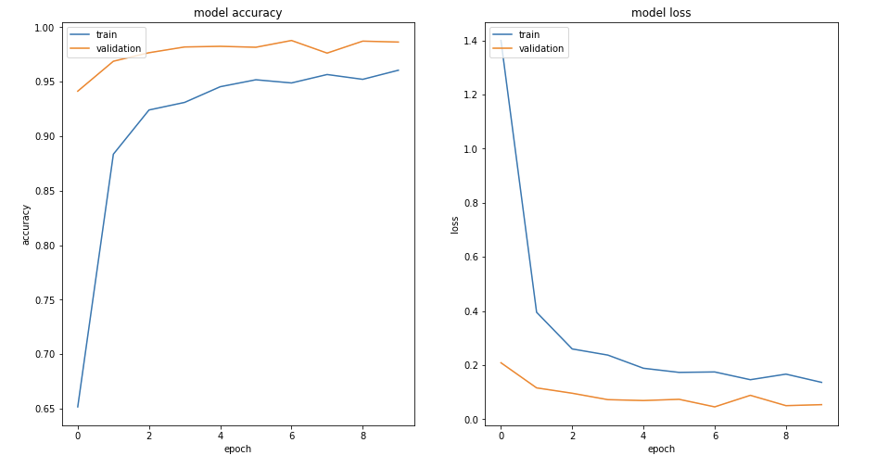
LEARNING CURVES

Slide 27
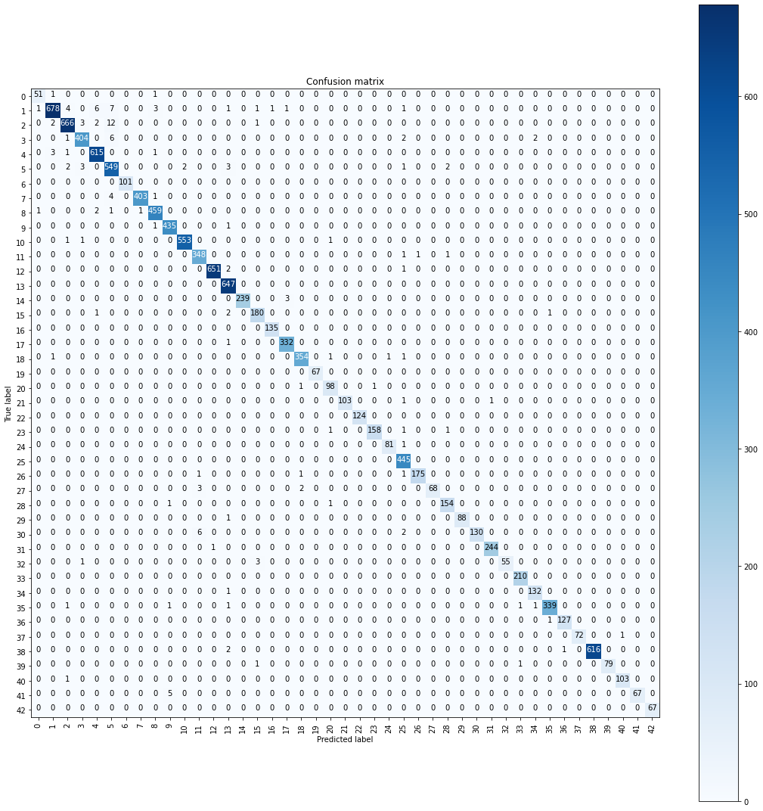
CONFUSION MATRIX
- VALIDATION

Slide 28
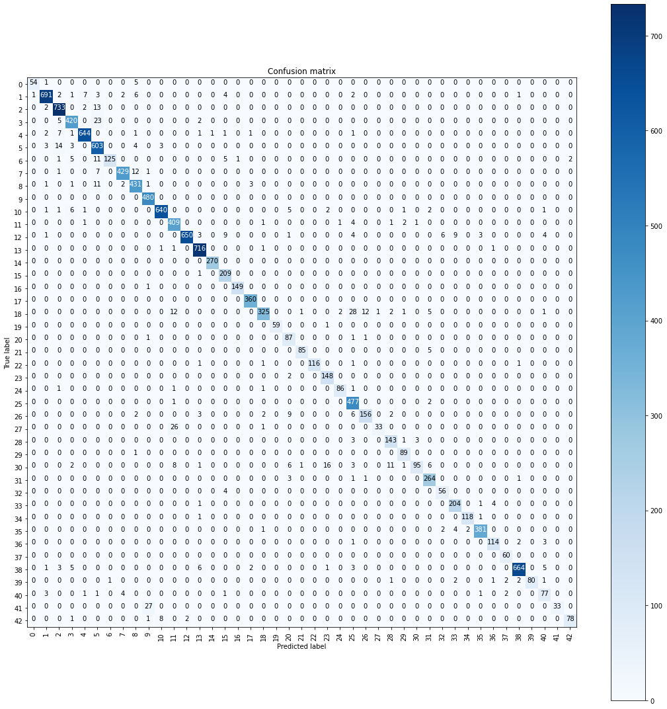
CONFUSION MATRIX
- UNSEEN TEST

Slide 29
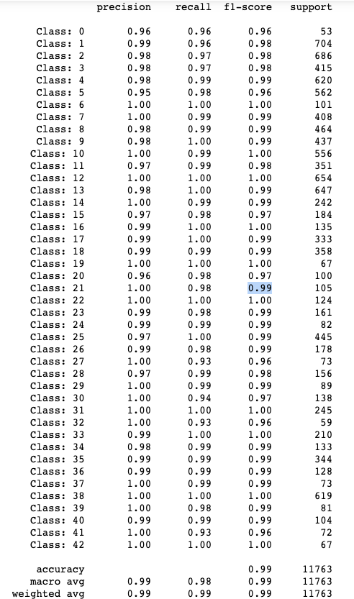
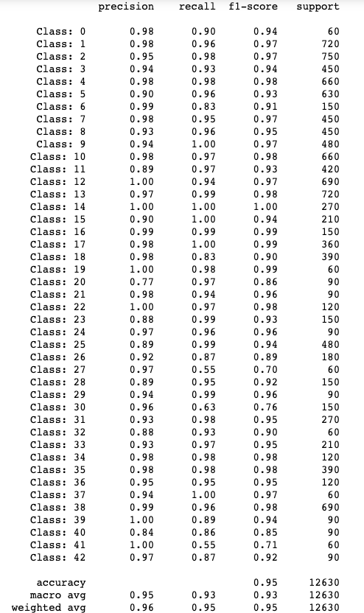
REPORT – UNSEEN TEST DATA
REPORT - VALIDATION

